Slide 1
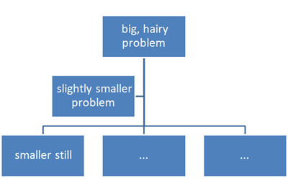
Functions

Slide 2
Triangle Formation Problem
Given three points, write an algorithm and the subsequent Python code to check if they can form a triangle. Three points can form a triangle, if they do not fall in a straight line and length of a side of triangle is less than the sum of length of other two sides of the triangle.

Slide 3
Triangle Formation Problem
For example, the points (5,10), (20,10) and (15,15) can form a triangle as they do not fall in a straight line and length of any side is less than sum of the length of the other two sides

Slide 4
Pseudocode for Triangle Formation
Read the three points
If the three points fall on a straight line then print “No Triangle” and break
Otherwise find length of all three sides
If length of one side is greater than the sum of length of the other two sides then print “Triangle” and print “No Triangle” otherwise

Slide 5
Pseudocode for Fall in Straight Line
input : X and Y coordinates of the three points
IF (pt1.x==pt2.x==pt3.x) THEN
RETURN true
ELIF (pt1.y==pt2.y==pt3.y) THEN
RETURN true
ELSE
RETURN false

Slide 6
Pseudocode for Distance between Two Points (Length of a side in a triangle)
input : X and Y coordinates of the two points
Distance = sqrt((pt1.x-pt2.x)**2 – (pt1.y-pt2.y)**2)
Return distance

Slide 7
Pseudocode for Checking Length Constraint
input : Length of three sides l1, l2, and l3
if l1<l2+l3 or l2<l1+l3 or l3<l1+l2:
return false
else:
return true

Slide 8
Sub Problems
Next 8 slides recall the concept of dividing a problem to sub problems

Slide 9
Bigger Problems
If you are asked to find a solution to a major problem, it can sometimes be very difficult to deal with the complete problem all at the same time.
For example building a car is a major problem and no-one knows how to make every single part of a car.
A number of different people are involved in building a car, each responsible for their own bit of the car’s manufacture.
The problem of making the car is thus broken down into smaller manageable tasks.
Each task can then be further broken down until we are left with a number of step-by-step sets of instructions in a limited number of steps.
The instructions for each step are exact and precise.

Slide 10
Top Down Design
Top Down Design uses the same method to break a programming problem down into manageable steps.
First of all we break the problem down into smaller steps and then produce a Top Down Design for each step.
In this way sub-problems are produced which can be refined into manageable steps.

Slide 11
Top Down Design for Real Life Problem
PROBLEM: To repair a puncture on a bike wheel. ALGORITHM:
1. remove the tyre
2. repair the puncture
3. replace the tyre

Slide 12
Step 1: Refinement:
Remove the tyre
1.1 turn bike upside down
1.2 lever off one side of the tyre
1.3 remove the tube from inside the tyre

Slide 13
Step 2: Refinement:
Repair the puncture Refinement:
2.1 find the position of the hole in the tube
2.2 clean the area around the hole
2.3 apply glue and patch

Slide 14
Step 3: Refinement:
3. Replace the tyre Refinement:
3.1 push tube back inside tyre
3.2 replace tyre back onto wheel
3.3 blow up tyre
3.4 turn bike correct way up

Slide 15
Still more Refinement:
Sometimes refinements may be required to some of the sub-problems, for example if we cannot find the hole in the tube, the following refinement can be made to 2.1:-

Slide 16
Still more Refinement:
Step 2.1: Refinement
2.1 Find the position of the hole in the tube
2.1.1 WHILE hole cannot be found
2.1.2 Dip tube in water
2.1.3 END WHILE

Slide 17
Python Functions
A function has a name that is used when we need for the task to be executed.
Asking that the task be executed is referred to as “calling” the function.
Some functions need one or more pieces of input when they are called. Others do not.
Some functions give back a value; others do not. If a function gives back a value, this is referred to as “returning” the value.

Slide 18
Why Functions?
To reduce code duplication and increase program modularity.
A software cannot be implemented by any one person, it takes a team of programmers to develop such a project.

Slide 19
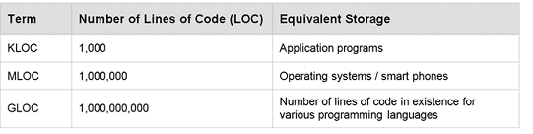

Slide 20
Functions Contd…
In order to manage the complexity of a large problem, it is broken down into smaller sub problems. Then, each sub problem can be focused on and solved separately.
Program routines provide the opportunity for code reuse, so that systems do not have to be created from “scratch.”

Slide 21
What Is a Function Routine?
A function or routine is a named group of instructions performing some task.
A routine can be invoked (called) as many times as needed in a given program
When a routine terminates, execution automatically returns to the point from which it was called.

Slide 22
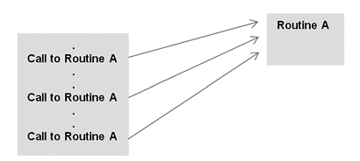

Slide 23

Defining Functions
Functions may be designed as per user’s requirement.
The elements of a function definition are given

Slide 24
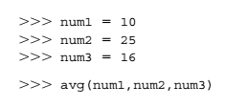
Defining Functions Contd…
The number of items in a parameter list indicates the number of values that must be passed to the function, called actual arguments (or simply “arguments”), such as the variables num1, num2,and num3 below.
Every function must be defined before it is called.

Slide 25
Parameters
Actual parameters, or simply “arguments,” - values passed to functions to be operated on.
Formal parameters, or simply the “placeholder” names for the arguments passed.
Actual parameters are matched with formal parameters by following the assignment rules

Slide 26
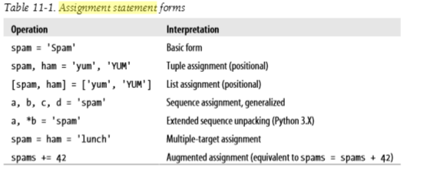
Assignment Statements Recap

Slide 27
Assignment Statements Recap
>>> [a, b, c] = (1, 2, 3) # Assign tuple of values to list of names
>>> a, c
(1, 3)
>>> (a, b, c) = "ABC"
# Assign string of characters to tuple
>>> a, c
('A', 'C')

Slide 28
Assignment Statements Recap
>>> seq = [1, 2, 3, 4]
>>> a, b, c, d = seq
>>> print(a, b, c, d)
1 2 3 4
>>> a, b = seq
ValueError: too many values to unpack (expected 2)

Slide 29
Assignment Statements Recap
>>> a, *b = seq
>>> a
1
>>> b
[2, 3, 4]

Slide 30
Assignment Statements Recap
>>> *a, b = seq
>>> a
[1, 2, 3]
>>> b
4

Slide 31
Assignment Statements Recap
>>> a, *b, c = seq
>>> a
1
>>> b
[2, 3]
>>> c
4

Slide 32
Assignment Statements Recap
>>> a, *b = 'spam'
>>> a, b
('s', ['p', 'a', 'm'])
>>> a, *b, c = 'spam'
>>> a, b, c
('s', ['p', 'a'], 'm‘)

Slide 33
Assignment Statements Recap
>>> a, *b, c = range(4)
>>> a, b, c
(0, [1, 2], 3)

Slide 34
Example Functions
def printer(message):
print('Hello ' + message)
def adder(a, b=1, *c):
return a + b + c[0]

Slide 35
Example Functions
>>> def times(x, y):
# Create and assign function ...
return x * y
# Body executed when called ...
When Python reaches and runs this def, it creates a new function object that packages the function’s code and assigns the object to the name times

Slide 36
Calls
>>> times(2, 4)
# Arguments in parentheses prints 8
>>> x = times(3.14, 4) # Save the result object >>> x
12.56
>>> times('Ni', 4) # Functions are "typeless" 'NiNiNiNi'

Slide 37
Example function
def intersect(seq1, seq2):
res = [] # Start empty
for x in seq1: # Scan seq1
if x in seq2: # Common item?
res.append(x) # Add to end return res

Slide 38
Example function
>>> s1 = "SPAM"
>>> s2 = "SCAM"
>>> intersect(s1, s2) # Strings
['S', 'A', 'M']

Slide 39
Equivalent Comprehension
>>> [x for x in s1 if x in s2]
['S', 'A', 'M']
Works for list also:
>>> x = intersect([1, 2, 3], (1, 4)) # Mixed types
>>> x # Saved result object [1]

Slide 40
Def Statements
creates a function object and assigns it to a name
def is a true executable statement: when it runs, it creates a new function object and assigns it to a name
Because it’s a statement, a def can appear anywhere a statement can—even nested in other statements

Slide 41
Def Statements
if test:
def func(): # Define func this way else:
def func(): # Or else this way ... .
func()
# Call the version selected and built

Slide 42
Function definition in selection statement Example
a = 4
if a%2==0:
def func():
print ('even')
else:
def func():
print('odd')
func()
Output:
even

Slide 43
Function definition in selection statement Example
a = 4
if a%2==0:
def func():
print ('even')
else:
def func():
print('odd')

Slide 44
Function definition in selection statement Example
# error no function print1 is defined
func()
Error in only condition satisfied item is found.
Otherwise code execute normal
Output:
even

Slide 45
Function definition in selection statement Example
a = 5
if a%2==0:
def func():
print ('even')
else:
def func():
print1('odd') # error no function print1 is defined
func()
Output:
error

Slide 46
Function Call through variable
def one():
print('one')
def two():
print('two')
def three():
print('three')

Slide 47
Function Call through variable
a = 3
if a == 1:
call_Func=one
elif a == 2:
call_Func=two
else:
call_Func=three
call_Func()
Notes:
def one():
print('one')
def two():
print('two')
def three():
print('three')
a = 3
if a == 1:
call_Func=one
elif a == 2:
call_Func=two
else:
call_Func=three
call_Func()

Slide 48
Scope of Variables
Enclosing module is a global scope
Global scope spans a single file only
Assigned names are local unless declared global or nonlocal
Each call to a function creates a new local scope

Slide 49
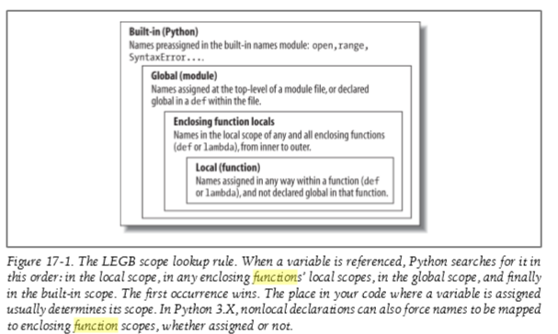
Name Resolution: The LEGB Rule

Slide 50
Scope Example
# Global scope
X = 99
# X and func assigned in module: global
def func(Y):
# Y and Z assigned in function: locals
# Local scope
Z = X + Y # X is a global
print (Z)
func(1) # func in module: result=100

Slide 51
Scope Example
Global names: X, func
Local names: Y, Z

Slide 52
Scope Example
X = 88 # Global X
def func():
X = 99
# Local X: hides global
func()
print(X) # Prints 88: unchanged

Slide 53
Accessing Global Variables
X = 88 # Global X
def func():
global X
X = 99 # Global X: outside def
func()
print(X) # Prints 99

Slide 54
Accessing Global Variables
y, z = 1, 2 # Global variables in module
def all_global():
global x # Declare globals assigned x = y + z
# No need to declare y, z: LEGB rule
Notes:
y, z = 1, 2 # Global variables in module
def all_global():
global x # Declare globals assigned
x = y + z
print(x)
all_global()

Slide 55
Nested Functions
X = 99 # Global scope name: not used
def f1():
X = 88 # Enclosing def local
def f2():
print(X)
f2()
f1() # Prints 88: enclosing def local

Slide 56
Return Functions
def f1():
X = 88
def f2():
print(X)
return f2 # Return f2 but don't call it
action = f1() # Make, return function
action() # Call it now: prints 88

Slide 57
Value-Returning Functions
Program routine called for its return value, and is therefore similar to a mathematical function.
Function avg takes three arguments (n1, n2, and n3) and returns the average of the three.
The function call avg(10, 25, 16), therefore, is an expression that evaluates to the returned function value.
This is indicated in the function’s return statement of the form return expr, where expr may be any expression.

Slide 58
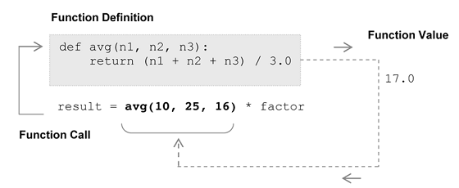
Notes:
def avg(n1,n2):
return(n1+n2)/2
result=avg(12,13)
print(result)

Slide 59
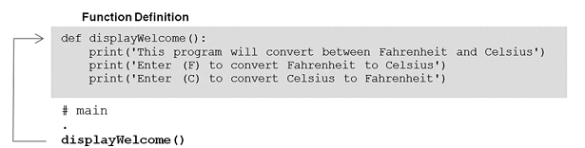
Non-Value-Returning Functions
A non-value-returning function is called not for a returned value, but for its side effects.
A side effect is an action other than returning a function value, such as displaying output on the screen.
In this example, function display Welcome is called only for the side-effect of the screen output produced.

Slide 60
Returning Multiple Values
>>> def multiple(x, y):
x = 2 # Changes local names only
y = [3, 4]
return x, y
# Return multiple new values in a tuple

Slide 61
Returning Multiple Values
>>> X = 1
>>> L = [1, 2]
>>> X, L = multiple(X, L)
# Assign results to caller's names
>>> X, L
(2, [3, 4])
Notes:
def multiple(x, y):
x = 2 # Changes local names only
y = [3, 4]
return x, y
X=1
L=[1,2]
X,L=multiple(X,L)
print(X,L)

Slide 62
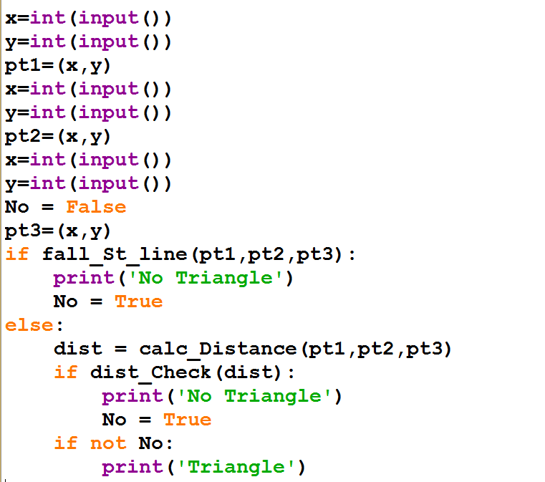

Slide 63
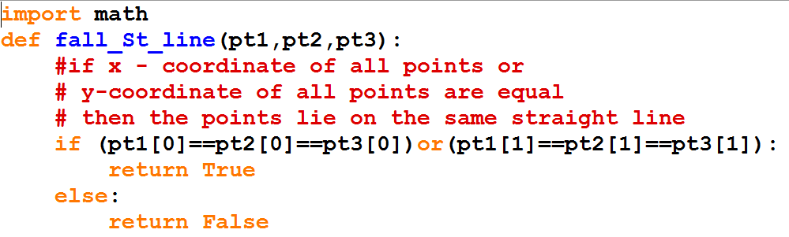
Notes:
import math
def fall_St_line(pt1,pt2,pt3):
if(pt1[0]==pt2[0]==pt3[0])or (pt1[1]==pt2[1]==pt3[1]):
return True
else:
return False
def calc_Distance(pt1,pt2,pt3):
d1=math.sqrt((pt1[0]-pt2[0])**2+(pt1[1]-pt2[1])**2)
d2=math.sqrt((pt2[0]-pt3[0])**2+(pt2[1]-pt3[1])**2)
d3=math.sqrt((pt1[0]-pt3[0])**2+(pt1[1]-pt3[1])**2)
return(d1,d2,d3)
def dist_Check(dist):
if dist[0]>(dist[1]+dist[2]):
return True
elif dist[1]>(dist[0]+dist[2]):
return True
elif dist[2]>(dist[1]+dist[0]):
return True
else:
return False
x=int(input())
y=int(input())
pt1=(x,y)
x=int(input())
y=int(input())
pt2=(x,y)
x=int(input())
y=int(input())
No=False
pt3=(x,y)
if fall_St_line(pt1,pt2,pt3):
print("No triangle")
No=True
else:
dist=calc_Distance(pt1,pt2,pt3)
if dist_Check(dist):
print("No Traingle")
No=True
if not No:
print("Triangle")

Slide 64
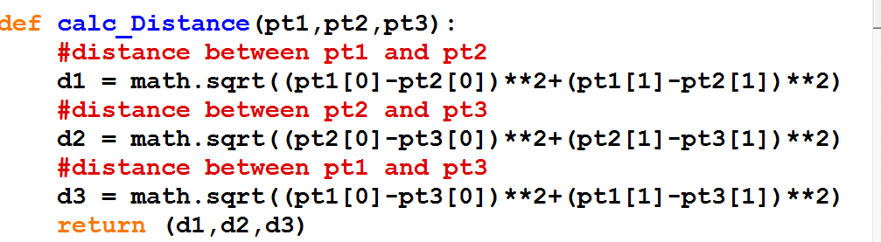

Slide 65
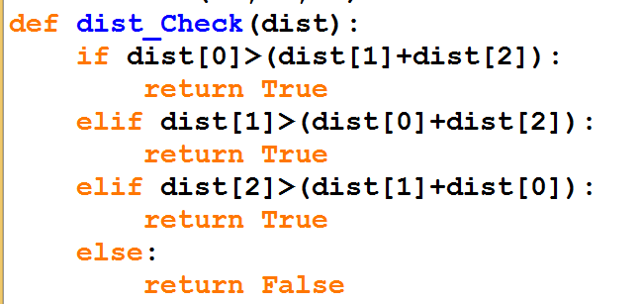

Slide 66
Exercises
Compute area of circle using function protypes.
Compute Simple interest for given principle(P), number of years(N) and rate of interest(R). If R value is not given then consider R value as 10.5%.
Notes:
import math
def SetArea (myradius):
myarea = math.pi * myradius ** 2
return myarea
print (SetArea(1))

